Slide 1
KETONE BODIES

Slide 2
Objectives
Name the ketone bodies (KBs)
Outline the synthetic pathway of KBs in the body
Explain how energy is produced from KBs
State the effects of increased levels of KBs in the body
Explain how the regulation of KB synthesis occur

Slide 3
Formation of Ketone bodies (KB)
Acetyl CoA produces in the liver during oxidation of fatty acid and amino acids mostly routed to the citric acid cycle
During Prolong fasting the amount of acetyl CoA exceeds the capacity of the citric acid cycle
Excess is used to form KBs

Slide 4
FFA
Acyl CoA
β Oxidation
Acetyl CoA
Ketogenesis
TCA cycle
Ketone bodies
CO2

Slide 5
Ketone Bodies (KBs)
Are alternative fuel in the body.
Synthesized in liver when there is high rate of fatty acids oxidation.
Three major forms
Acetoacetate
D-3-hydroxy butyrate
Acetone.
They are water soluble and energy yielding
They are buffered when present in blood and tissues

Slide 6
Ketogenesis
Occurs in liver mitochondria
Precursor is the acetyl CoA formed by oxidation of FA, pyruvate or ketogenic amino acids.

Slide 7
Ketogenesis
2 Acetyl CoA
Thiolase
Acetoacetyl CoA
HMG CoA synthase
HMG CoA
NADH + H⁺
HMG CoA lyase
NAD⁺
Acetoacetate
Spontaneous
NADH + H⁺
3-Hydroxybutyrate dehydrogenase
CO₂
Acetone
NAD⁺
3-Hydroxybutyrate

Slide 8
HMG Co A synthesis in liver occur in both cytoplasm and mitochondia
HMG Co A lyase absent in cytoplasm
HMG CoA
Mitochondria
cytoplasm
KB
Cholesterol

Slide 9
Utilization of KB
By extra hepatic tissue (in the mitochondria).
Can transport in blood unbound as KB are water-soluble.
Acetoacetate and 3-hydroxybutyrate are serve as important sources of energy in Skeletal muscles, Cardiac muscles and renal cortex.
Tissues which lack mitochondria cannot utilize KB.
Liver cannot utilize KB.

Slide 10
Significant utilization when glucose is short supply to the tissues.
Brain adapts to utilize KB in hypoglycemic conditions.
Acetone cannot metabolize and exhaled in breath.
The interconversion of Acetoacetate to D-3-hydroxybutyrate is controlled by mitochondrial NAD /NADH ratio

Slide 11
Utilization of KB cont….
3-Hydroxybutyrate
NAD⁺
NADH + H⁺
Acetoacetate
Not found in liver
Succinyl Co A
Co A transferase
Succinate
Acetoacetyle CoA
Co A
thiolase
2 Acetyle CoA

Slide 12
Ketoacidosis
Over production of KB due to the rate of formation of KB grater than their rate of use
Normal levels of blood are 1mg/dl.
Ketonemia - A condition of high levels of KB in blood
Ketonuria - excretion of KB in urine
Ketonemia results acidemia, dehydration and ketoacidosis.

Slide 13
Causes of Ketosis
Starvation
Pathologic status- Diabetes melitus
Non pathologic
- High fat feed
- Severe exercise in post absorptive state

Slide 14
Regulation of ketogenesis
1.Hydrolysis of triacylglyerol in adipose tissue. Insulin, Glucogon, epinephrine, nor epinephrine
2.Entry of acylCoA into the mitochondria
CPT1 gateway
3.At the step where the acetyl-CoA convert to KB

Slide 15
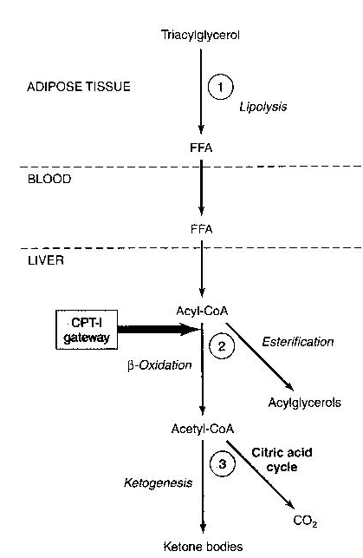
Regulation of
ketogenesis
fï

Slide 16
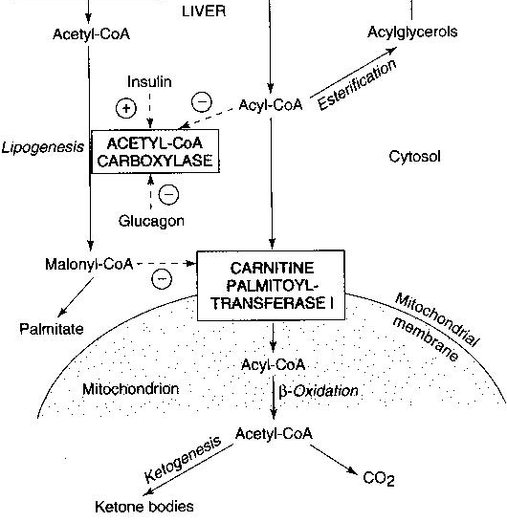
Glucose
FFA
VLDL

Slide 17
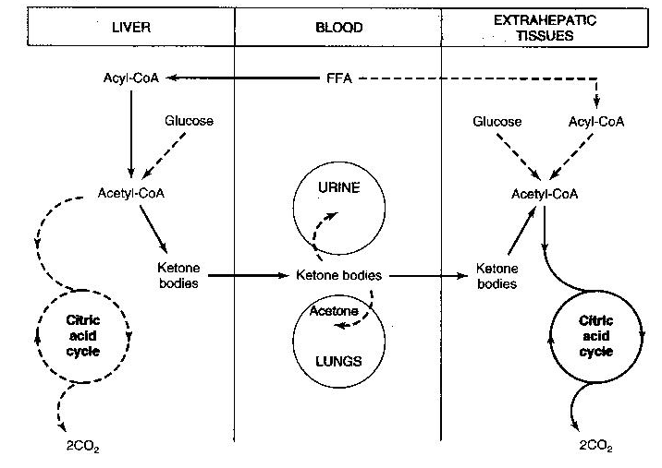
Summary

